Slide 1
Employee Health Insurance Forum December 8, 2025
Notes:
Welcome everyone
Introduce myself
Copies of slides up front
Microphones are available, if needed
32 people

Slide 2
Agenda
What is the problem?
How do we solve it?
Questions, comments, suggestions
Ground Rules
Notes:
Ground rules
Defining the problem
Proposed solutions
Next steps
Introduce Wendy

Slide 3
Ground Rules
Please be respectful
Please ask any and all questions you may have
Employees may actively participate, guests are welcome to listen in
Notes:
Please use microphones, if necessary

Slide 4
What is the problem? Employee Benefit Cost Increases
Anticipated Employee Benefit Cost Increases for FY27
$2,043,726 (Budgeting for a 18% increase in health insurance costs)
+$657,335 (Budgeting for a 10% increase in retirement assessment costs)
$2,701,061 (Health & Retirement Cost Increase)
-$2,604,641 (2.5% + New Growth + Local Receipts + State Aid Increase)
($96,420)
Total “Level 1” Increase = $6,107,474 (7.33%)
Anticipated Level Service Budget Deficit = ($2,222,069)
Notes:
Town increase=3.1%
School increase=2.5%
Total increase=7.3%
Level 1=all town department requests + conservative revenue estimates

Slide 5
What are the options?
Everything is on the table, but likely involves some of these options:
Proposition 2.5 Override
Budget Cuts, including Limiting Office Hours
Cutting Services, including Trash & Recycling Service
Increasing the Trash Fee (again)
Health Insurance Plan Design & Premium Contribution Sharing Changes
Current health insurance “splits” are 78/22. Our goals:
75/25 (HMO & PPO) for current employees, and/or
70/30 (HMO) & 60/40 (PPO) for new employees, and/or
Plan design changes (to be discussed)
Possible compensation in return, includes cash, HRA, ???

Slide 6
Notes:
Add springfield, Chicopee, and Holyoke to the comp grid
Update employee costs for proposals 1 & proposal 2

Slide 7
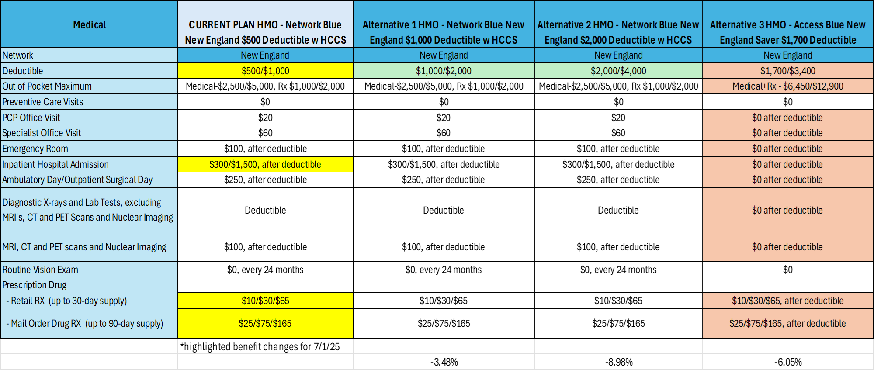

Slide 8
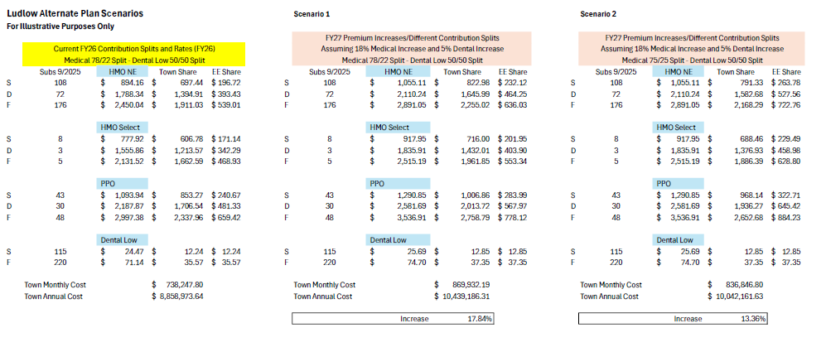

Slide 9
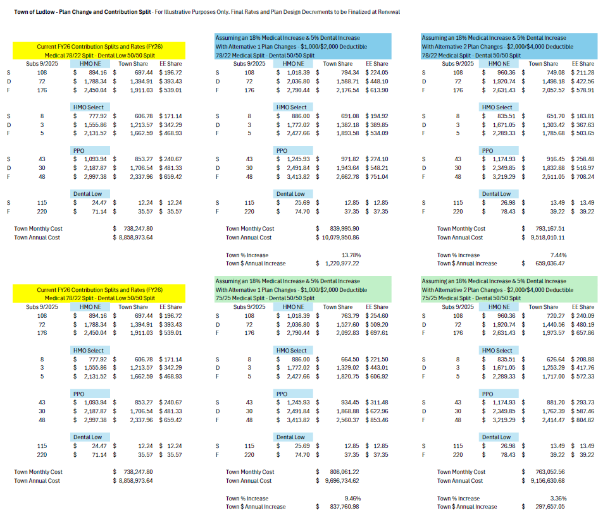

Slide 10
Initial Proposals
Proposal #1
Change Split from 78/22 to 75/25 for current employees
70/30 (HMO), 60/40 (PPO) for new employees
Change Deductible from $500/$1000 to $1000/$2000 (Alternative #1)
FY27 Budget Savings=$742,451
Changes to Splits are not obligatory and must be accepted by Collective Bargaining Units
Proposal #2
Change Deductible from $500/$1000 to $2000/$4000 (Alternative #2)
FY27 Budget Savings=$921,176
Plan design changes are allowed by statute—proposal to share savings with Collective Bargaining Units is required (M.G.L. c.32B, secs. 21-23)

Slide 11
CURRENT RESERVE BALANCES
Free Cash
$3,065,070
Stabilization
$7,537,173

Slide 12
Next Steps
QUESTIONS, COMMENTS, SUGGESTIONS?
What information can we provide?
Next IAC Meeting: December 15th @ 3:30PM

