Slide 1


Slide 2

Notes:
Please feel free to ask questions as we go, after each slide, or at the end.
Before we get started, just a quick acknowledgment that we are aware of the issues with some 2026 sewer bills and our team is working on it. We have an idea in general what happened, but want to be sure we understand the issues fully before communicating more on the that.

Slide 3
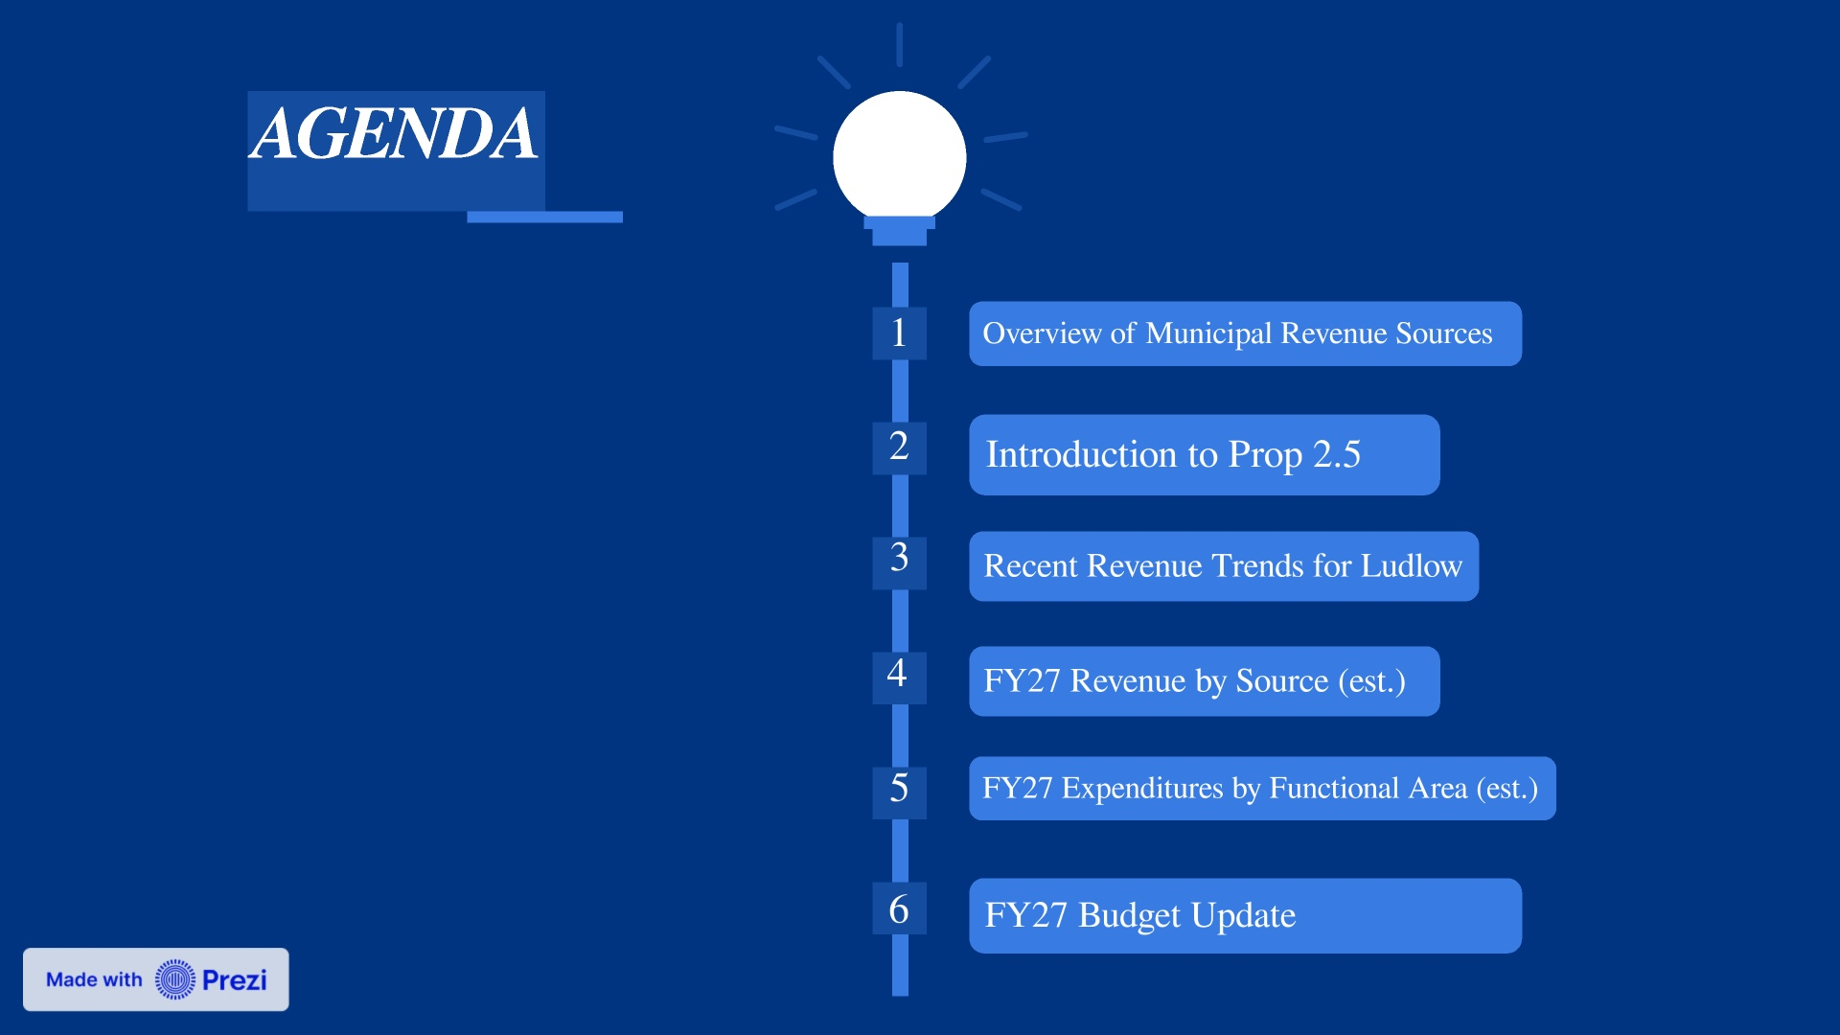

Slide 4
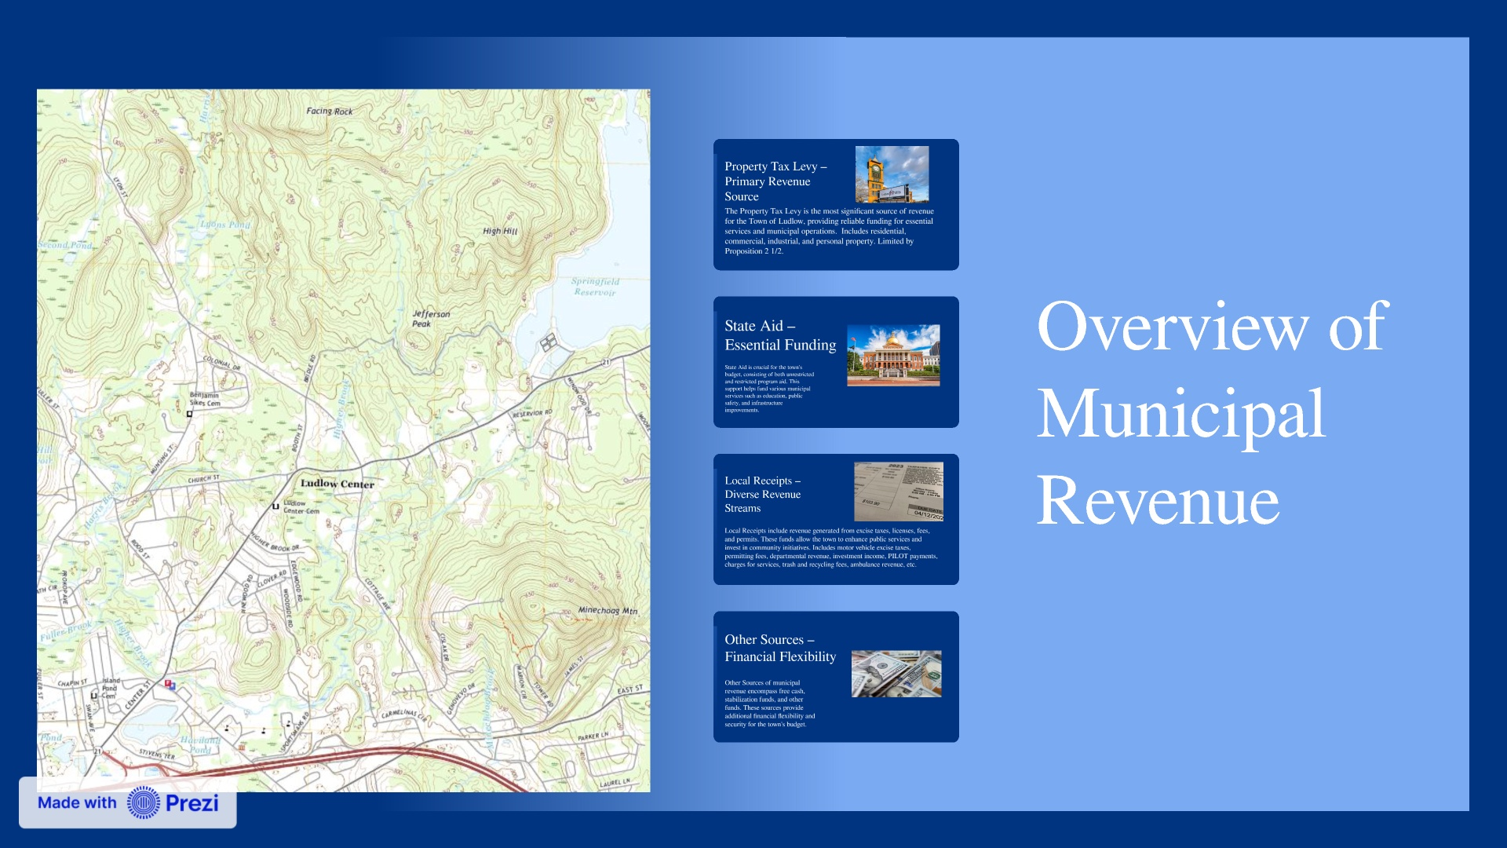

Slide 5
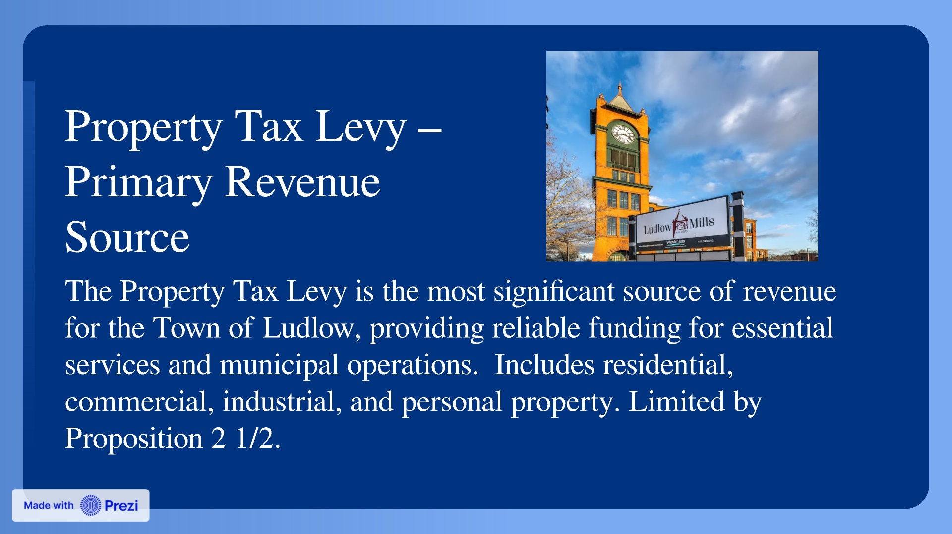

Slide 6


Slide 7
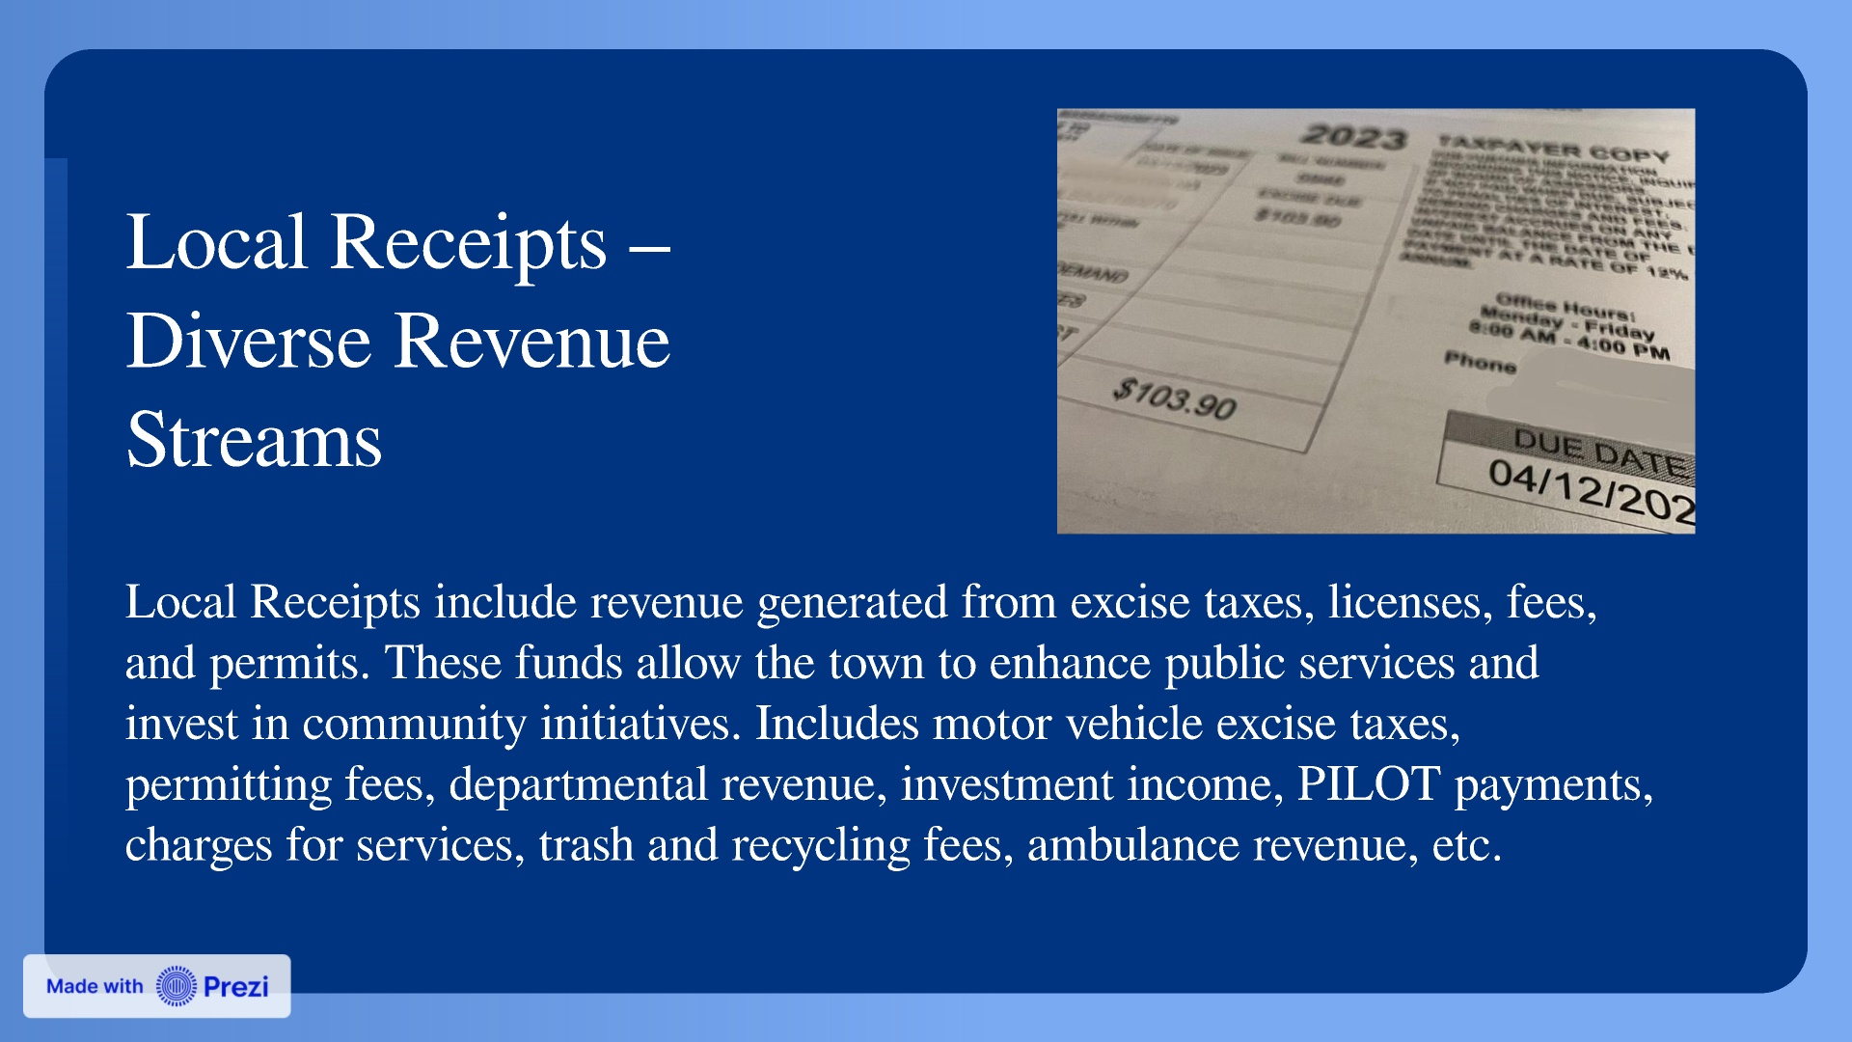

Slide 8


Slide 9
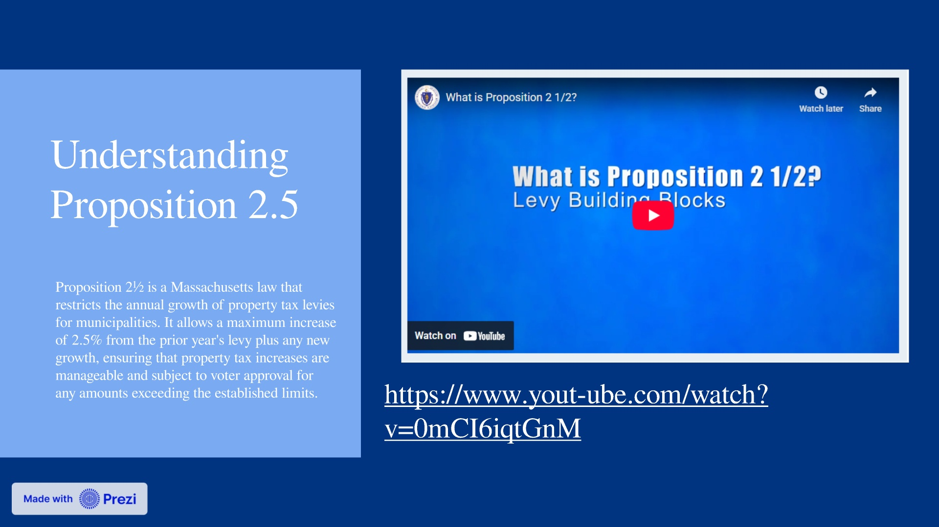

Slide 10
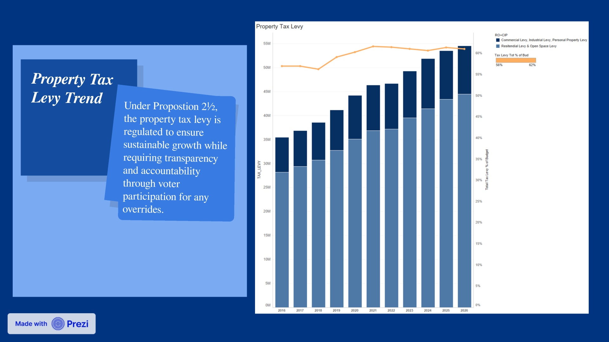
Notes:
Limited by Prop 2.5 + New Growth

Slide 11
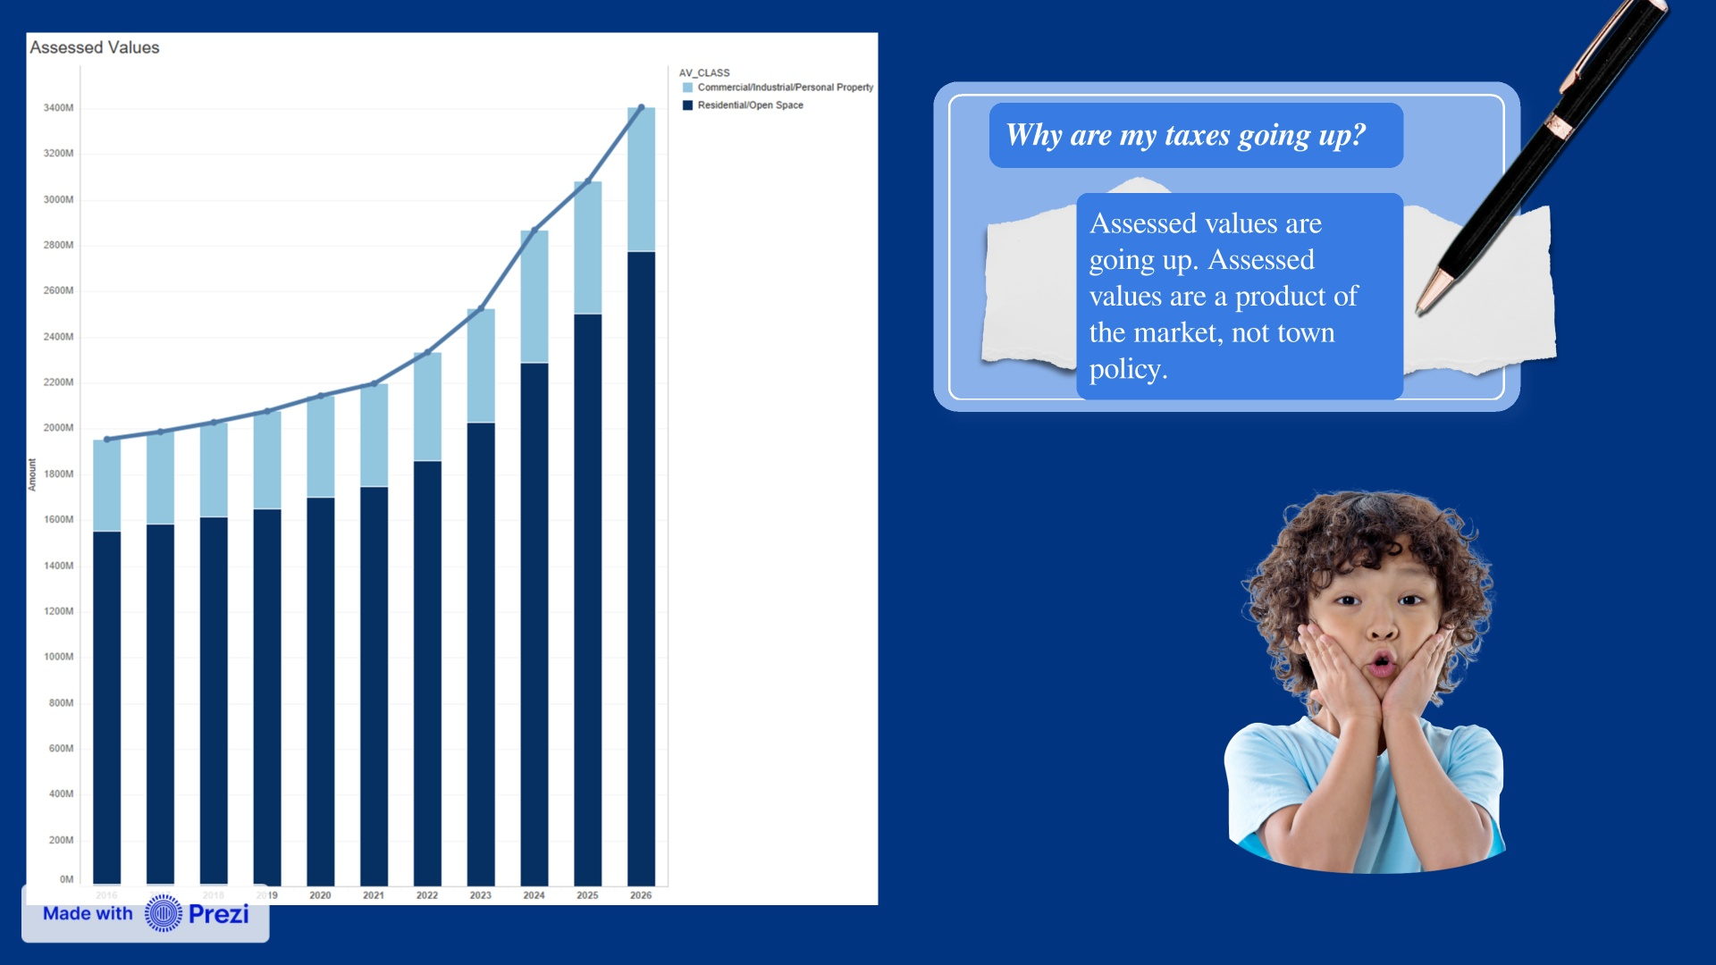

Slide 12
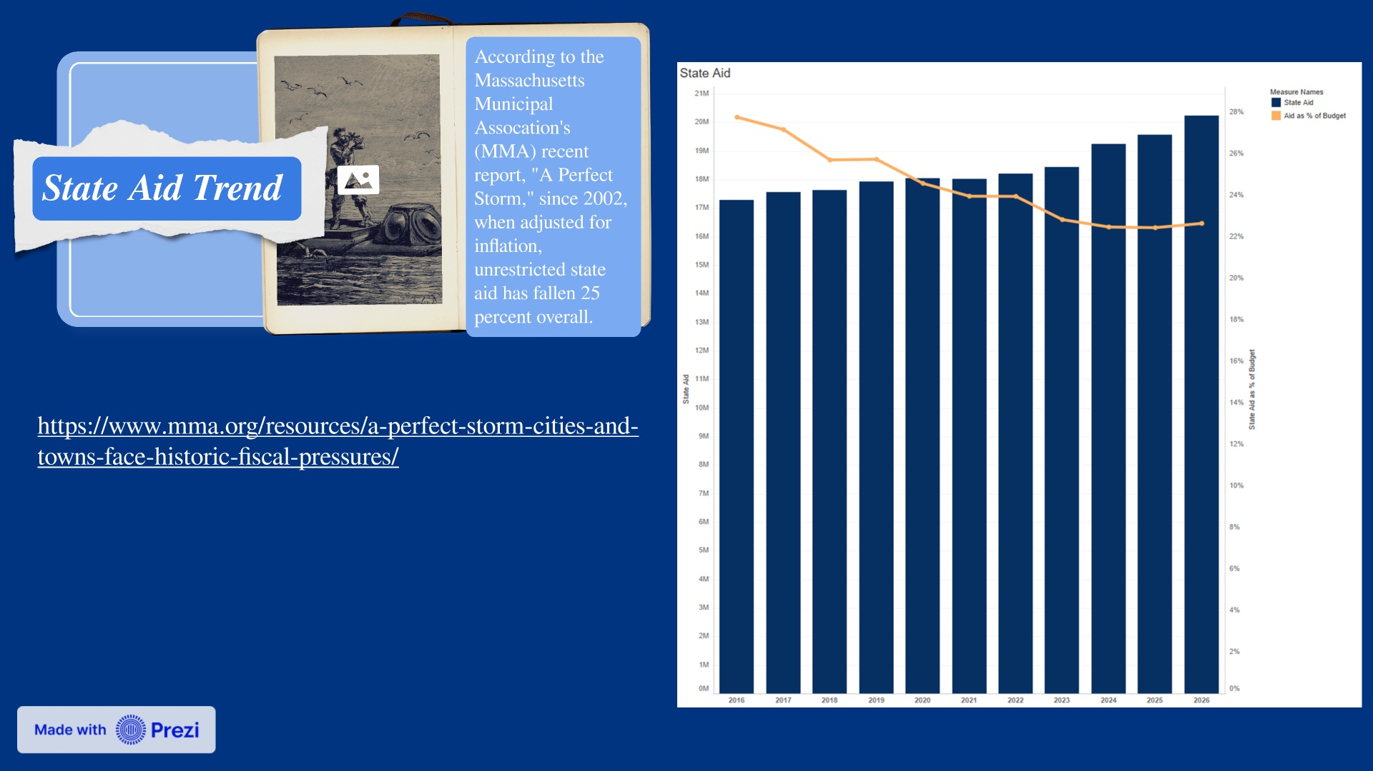

Slide 13
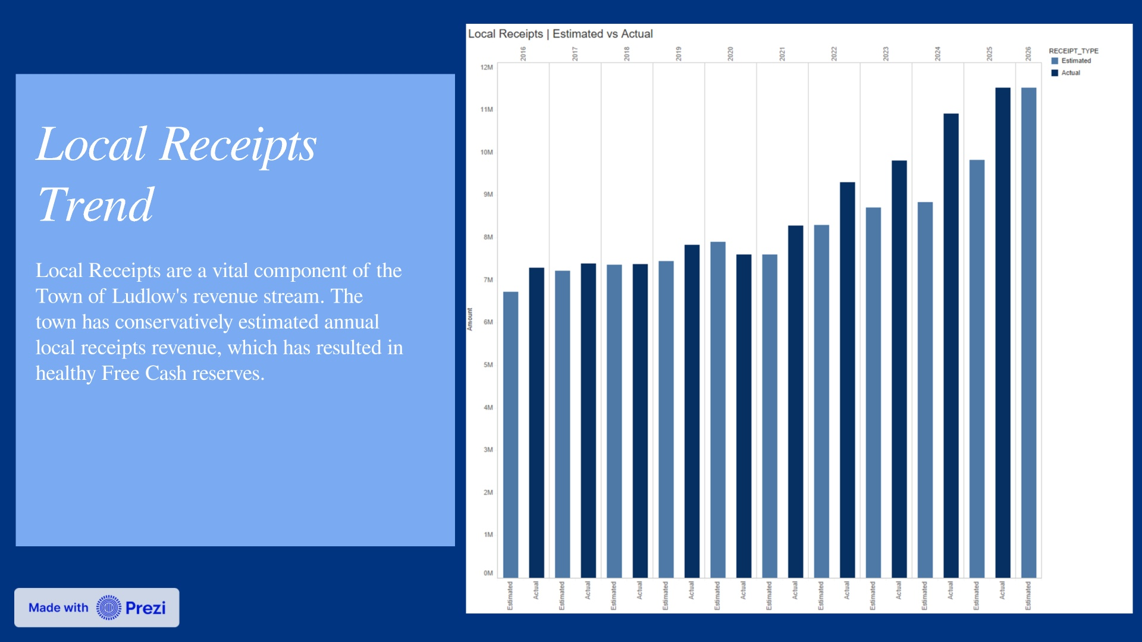

Slide 14
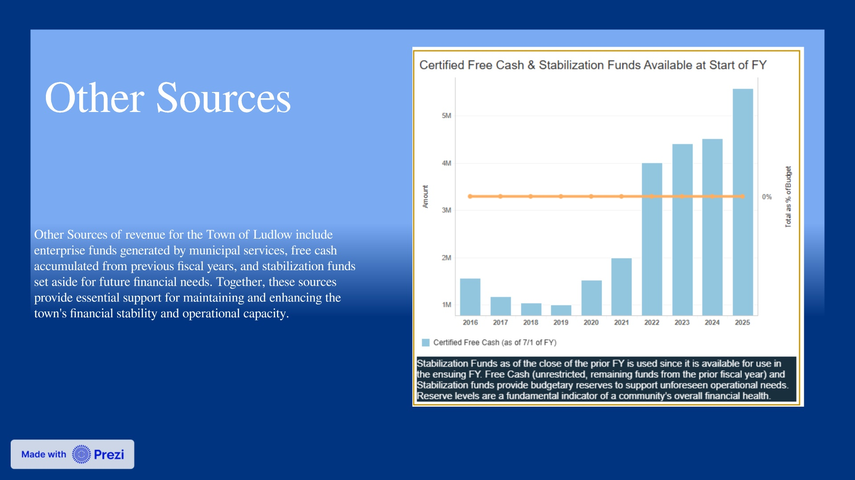

Slide 15
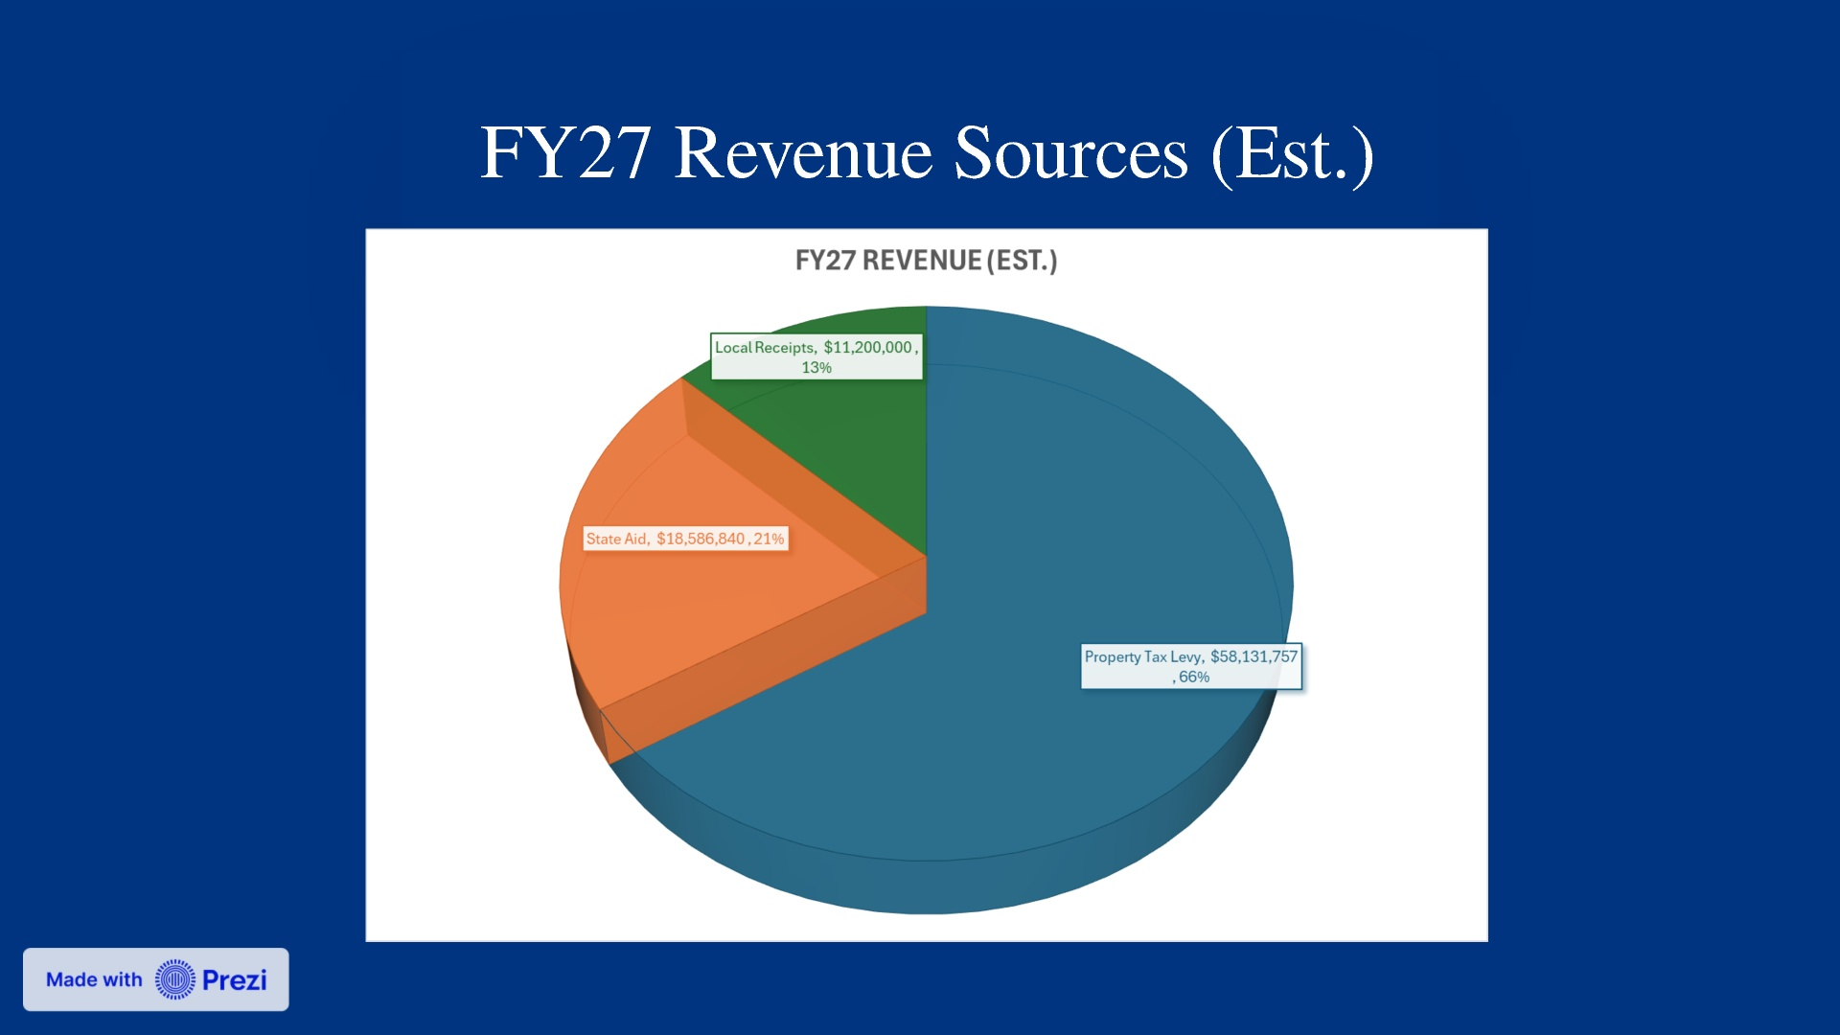

Slide 16
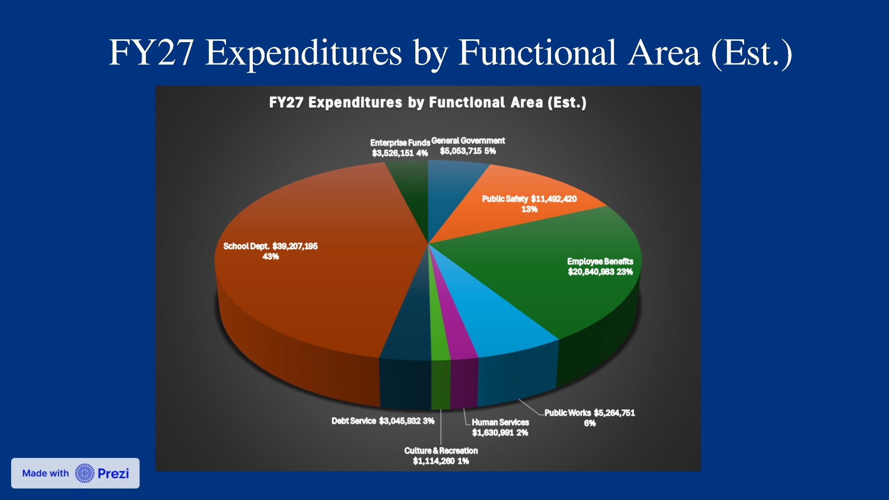

Slide 17
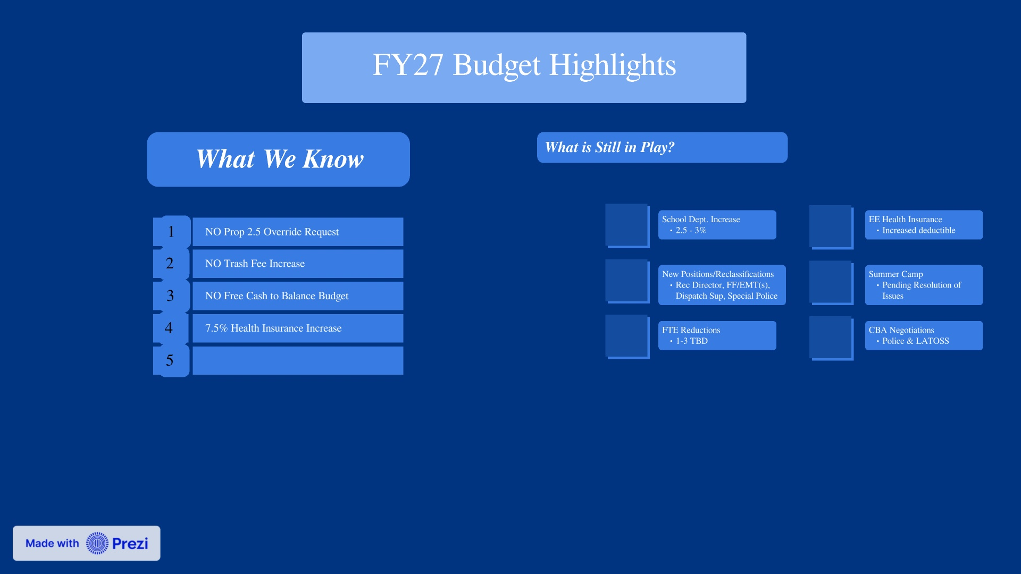

Slide 18
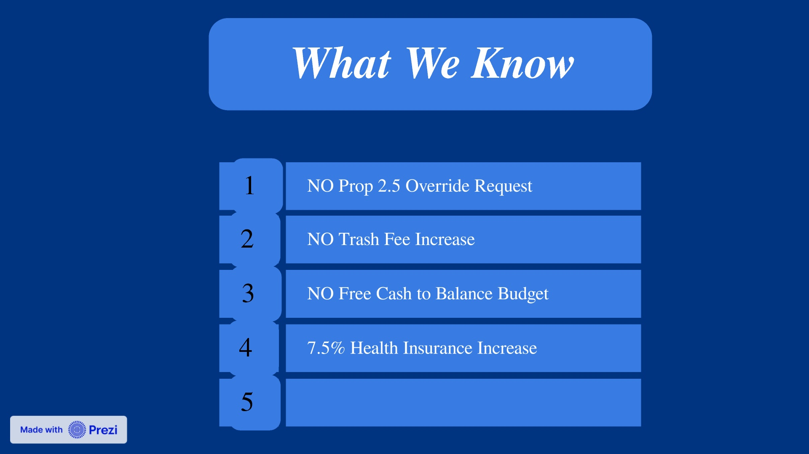

Slide 19
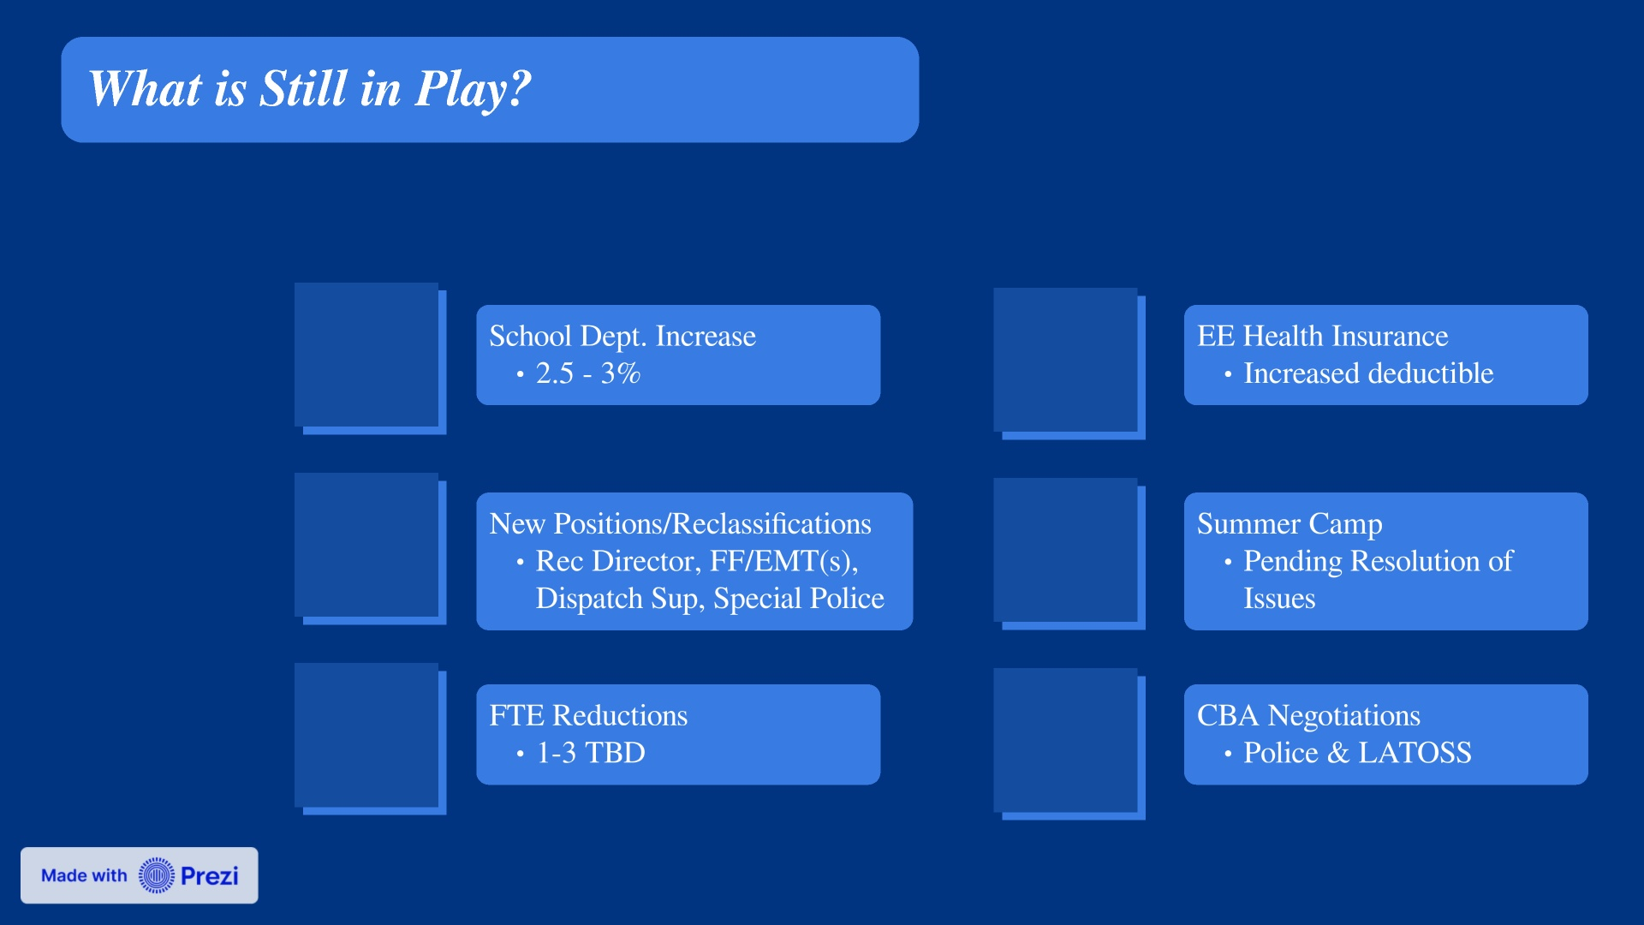

Slide 21

